Slide 1
Modern Programming Languages
UIIT PMAS Arid Agriculture University, Rawalpindi
Course Instructor: Suleman Khurram

Slide 2
Exception Handling
Java uses exceptions as a way of signaling serious problems when you execute a program.

Slide 3
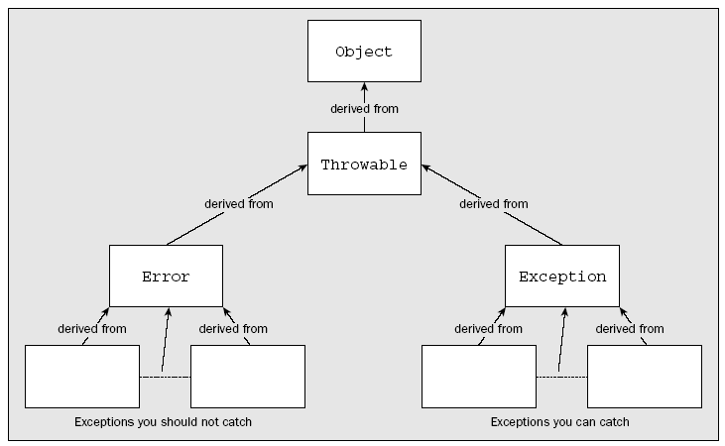
Types of Exceptions

Slide 4
Error Exceptions
They represent conditions that you aren’t expected to do anything about, so you aren’t expected to catch
Error has three direct subclasses
ThreadDeath
LinkageError
VirtualMachineError

Slide 5
Error Exceptions
A ThreadDeath exception is thrown whenever an executing thread is deliberately stopped, and for the thread to be destroyed properly, you should not catch this exception
The LinkageError exception class has subclasses that record serious errors with the classes in your program. Incompatibilities between classes or attempting to create an object of a nonexistent class type are the sorts of things that cause these exceptions to be thrown.
The VirtualMachineError class has four subclasses that specify exceptions that will be thrown when a catastrophic failure of the Java Virtual Machine occurs.
The exceptions that correspond to objects of classes derived from LinkageError and VirtualMachineError are all the result of catastrophic events or conditions. You can do little or nothing to recover from them during the execution of the program.

Slide 6
Exception Class
All the exceptions that are represented by subclasses of the Exception class, you must include code in your programs to deal with them if your code may cause them to be thrown

Slide 7
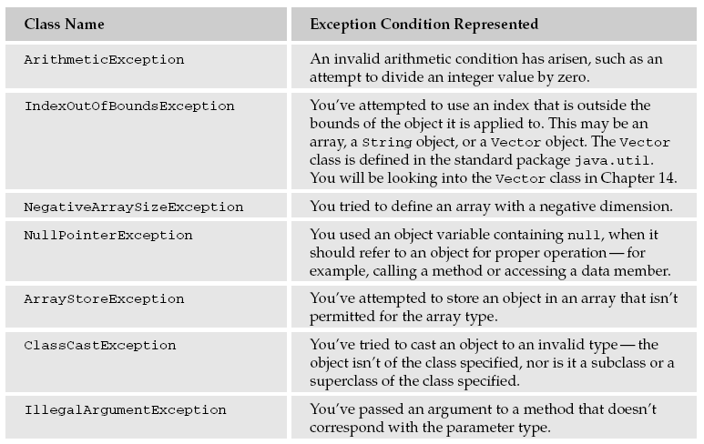
Subclasses of Exception Class

Slide 8
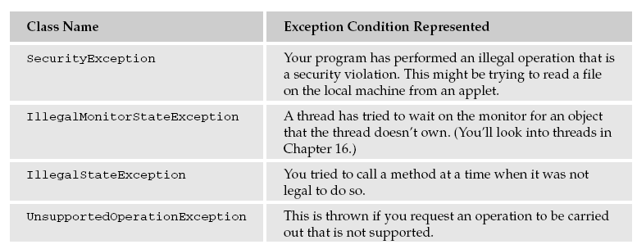
Subclasses of Exception Class

Slide 9
Dealing with Exceptions
Adding Throw Clause to methods
The calling method definition must either deal with the exceptions or declare that it can throw these exceptions as well.
double myMethod() throws IOException, FileNotFoundException {
// Detail of the method code...
}

Slide 10
Dealing with Exceptions
If you want to deal with the exceptions where they occur, you can include three kinds of code blocks in a method to handle them—try, catch, and finally blocks:

Slide 11
Try Catch and finally blocks
A try block encloses code that may give rise to one or more exceptions. Code that can throw an exception that you want to catch must be in a try block.
A catch block encloses code that is intended to handle exceptions of a particular type that may be thrown in the associated try block.
The code in a finally block is always executed before the method ends, regardless of whether any exceptions are thrown in the try block.

Slide 12
The try Block
A try block is simply the keyword try, followed by braces enclosing the code that can throw the exception
try {
// Code that can throw one or more exceptions
}

Slide 13
The catch Block
You enclose the code to handle an exception of a given type in a catch block
The catch block must immediately follow the try block that contains the code that may throw that particular exception.
try {
// Code that can throw one or more exceptions
} catch(ArithmeticException e) {
// Code to handle the exception
}

Slide 14
The catch Block
This catch block handles only ArithmeticException exceptions.
This implies that this is the only kind of exception that can be thrown in the try block.
If others can be thrown, this won’t compile.

Slide 15
Try and a catch Block - Example
public class TestTryCatch {
public static void main(String[] args) {
int i = 1;
int j = 0;
try {
System.out.println(“Try block entered “ + “i = “+ i + “ j = “+j);
System.out.println(i/j); // Divide by 0 - exception thrown
System.out.println(“Ending try block”);
}
catch(ArithmeticException e) { // Catch the exception
System.out.println(“Arithmetic exception caught”);
}
System.out.println(“After try block”);
return;
}
}

Slide 16
Try and a catch Block - Example (Divide by zero error)
public class TestLoopTryCatch {
public static void main(String[] args) {
Exceptions
int i = 12;
for(int j=3 ;j>=-1 ; j--)
try {
System.out.println(“Try block entered “ + “i = “+ i + “ j = “+j);
System.out.println(i/j); // Divide by 0 - exception thrown
System.out.println(“Ending try block”);
}
catch(ArithmeticException e) { // Catch the exception
System.out.println(“Arithmetic exception caught”);
}
System.out.println(“After try block”);
return;
}
}
}

Slide 17
Multiple catch Blocks
try {
// Code that may throw exceptions
}
catch(ArithmeticException e) {
// Code for handling ArithmeticException exceptions
}
catch(IndexOutOfBoundsException e) {
// Code for handling IndexOutOfBoundsException exceptions
}
// Execution continues here...

Slide 18
Single catch Block with multiple exceptions
Since Java 7
try {
// Code that may throw exceptions
}
catch(ArithmeticException | IndexOutOfBoundsException e) {
// Code for handling both
//or
if (e instanceof ArithmeticException){
}
if (e instanceof IndexOutOfBoundsException){
}
}
// Execution continues here...

Slide 19
The finally Block
The finally block provides the means for you to clean up at the end of executing a try block.
You use a finally block when you need to be sure that some particular code is run before a method returns
finally {
// Clean-up code to be executed last
}

Slide 20
The Throwable Class
The Throwable class is the class from which all Java exception classes are derived—that is, every exception object will contain the methods defined in this class.
The Throwable class has two constructors: a default constructor and a constructor that accepts an argument of type String
Objects of type Throwable contain two items of information about an exception:
A message, which I have just referred to as being initialized by a constructor
A record of the execution stack at the time the object was created

Slide 21
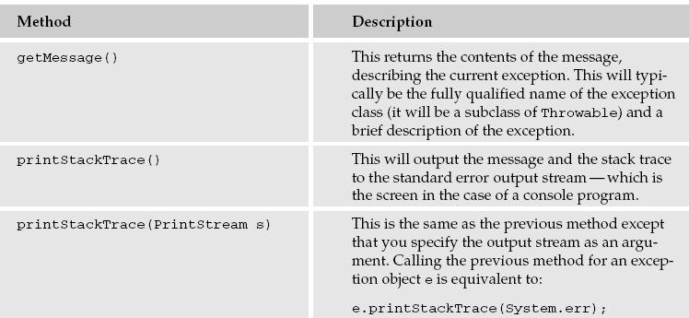
Methods of Throwable Class

Slide 22
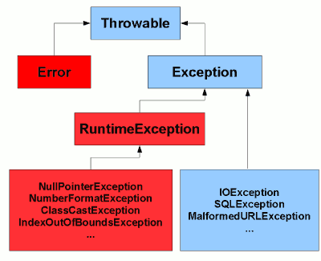
Checked and Unchecked exceptions

Slide 23
Checked exceptions
Checked exceptions are checked by the Java compiler so they are called compile time exceptions.
Java compiler forces us to handle these exceptions in some manner in the application code.
Note that all checked exceptions are subclasses of Exception class. For example,
ClassNotFoundException
IOException
SQLException

Slide 24
Checked exceptions
public static void main(String[] args)
{
FileReader file = new FileReader("somefile.txt");
}
In above case, you will get compile time error with message – Unhandled exception type FileNotFoundException.
public static void main(String[] args)
{
try
{
FileReader file = new FileReader("somefile.txt");
}
catch (FileNotFoundException e)
{
//Alternate logic
e.printStackTrace();
}
}

Slide 25
Unchecked exceptions
Unchecked exceptions are not checked by the compiler. These are called runtime exceptions.
Unchecked Exceptions are subclasses of RuntimeException class.
ArithmeticException
ArrayStoreException
ClassCastException

Slide 26
Unchecked exceptions
JVM not forcing us to check NullPointerException
public static void main(String[] args)
{
try
{
FileReader file = new FileReader("pom.xml");
file = null;
file.read();
}
catch (IOException e)
{
//Alternate logic
e.printStackTrace();
}
}

Slide 27
Exercise
What will be the output?
public class ExceptionHandling
{
public static void main(String[] args)
{
try
{
int i = Integer.parseInt("abc"); //This statement throws NumberFormatException
}
catch(Exception ex)
{
System.out.println("This block handles all exception types");
}
catch(NumberFormatException ex)
{
System.out.println(“Number format exception occurred"); }
}
}

Slide 28
Exercise
public class ExceptionHandling
{
public static void main(String[] args)
{
try
{
int i = Integer.parseInt("abc"); //This statement throws NumberFormatException
}
catch(Exception ex)
{
System.out.println("This block handles all exception types");
}
catch(NumberFormatException ex)
{
//Compile time error
//This block becomes unreachable as
//exception is already caught by above catch block
}
}
}

Slide 29
Exercise
Try to write a program and throw an exception explicitly

Slide 30
Exercise
Try to write a program and throw an exception explicitly
try
{
NumberFormatException ex = new NumberFormatException();
throw ex; //throwing NumberFormatException object explicitly using throw keyword
}
catch(NumberFormatException ex)
{
System.out.println("explicitly thrown NumberFormatException object will be caught here");
}

